Slide 1

人工智能实践
Artificial Intelligence Practice
DCS3015 Autumn 2022
Chao Yu （余超）
School of Computer Science and Engineering
Sun Yat-Sen University

Slide 2
Lecture 5：强化学习-6
Multi-Agent RL

Slide 3
Multi-Agent RL
What is the multi-agent reinforcement learning(MARL)?
What is the difference between single-agent reinforcement learning and multi-agent reinforcement learning?
What is the difficulty in the multi-agent reinforcement learning?
What are the categories of multi-agent reinforcement learning?

Slide 4
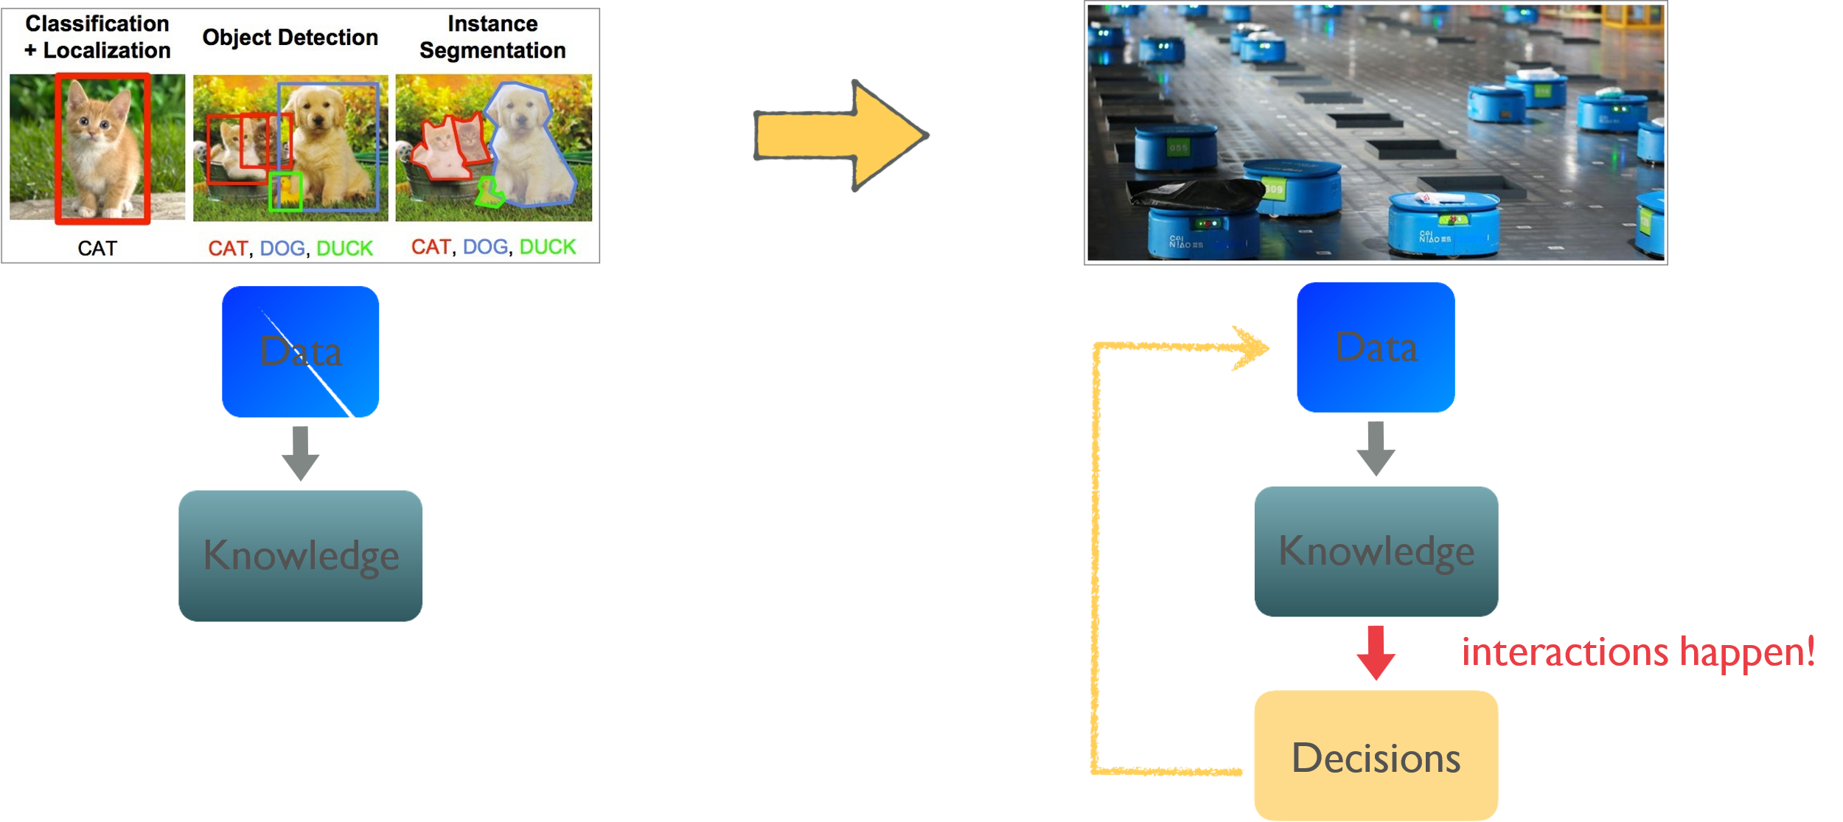
Multi-Agent RL
What is the multi-agent reinforcement learning(MARL)?
Reinforcement learning turns data/knowledge into closed-loop decision making.
Multi-agent learning deal with interactions among the learning agents.

Slide 5
Multi-Agent RL
What is the multi-agent reinforcement learning(MARL)?
MARL addresses the sequential decision-making problem of multiple autonomous agents that operate in a common environment, each of which aims to optimize its own long-term return by interacting with the environment and other agents
A group of agents work together to optimize team performance
Multiagent systems include a set of autonomous entities(agents) that share a common environment and where each agent can independently perceive environment, act acting to its individual objectives and as a consequence, modify the environment
In an multiagent system, agents must compete or cooperate to obtain the best overall results.

Slide 6
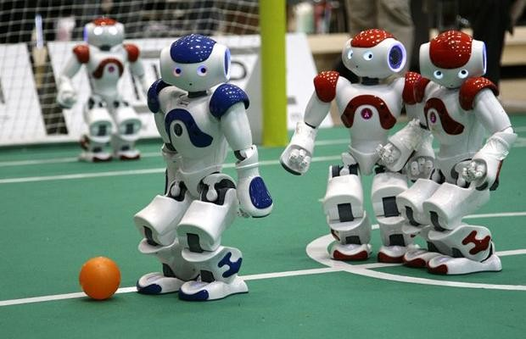
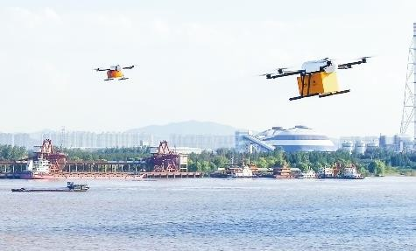
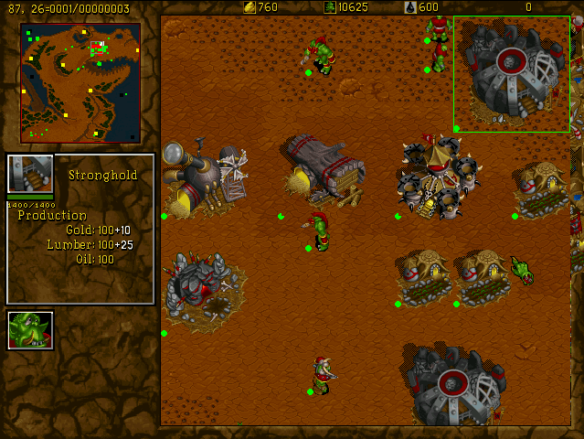
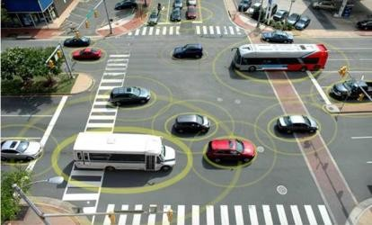
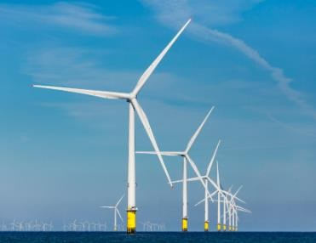
Multi-Agent RL
What is the multi-agent reinforcement learning(MARL)?
Robots
Drone Delivery
Games
Autonomous Vehicles
Smart Grids
MALib

Slide 7
Multi-Agent RL
What is the multi-agent reinforcement learning(MARL)?
What is the difference between single-agent reinforcement learning and multi-agent reinforcement learning?
What is the difficulty in the multi-agent reinforcement learning?
What are the categories of multi-agent reinforcement learning?

Slide 8
Multi-Agent RL
What is the difference between single-agent reinforcement learning and multi-agent reinforcement learning?
Single-agent RL:
Only one agent
State、local action、single reward
Multi-agent RL:
At least two agents
Local observation、joint action、team reward
Agents communicate with each other and interact with environment at the same time.

Slide 9
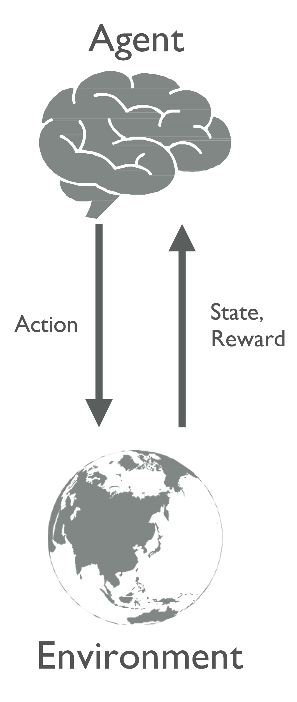
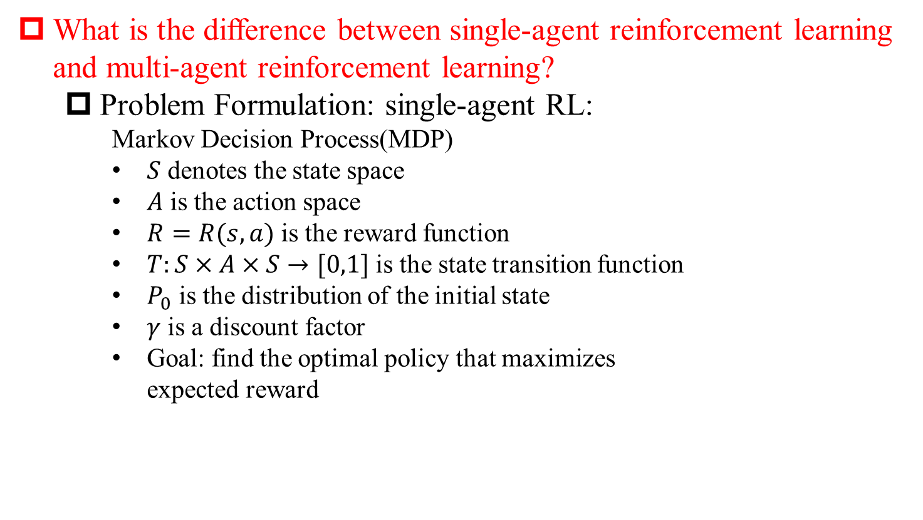
Multi-Agent RL
What is the difference between single-agent reinforcement learning and multi-agent reinforcement learning?
Problem Formulation: single-agent RL:
Markov Decision Process(MDP)
$S$ denotes the state space
$A$ is the action space
$R=R(s,a)$ is the reward function
$T:S×A×S→[0,1]$ is the state transition function
$P_{0}$ is the distribution of the initial state
$γ$ is a discount factor
Goal: find the optimal policy that maximizes expected reward

Slide 10
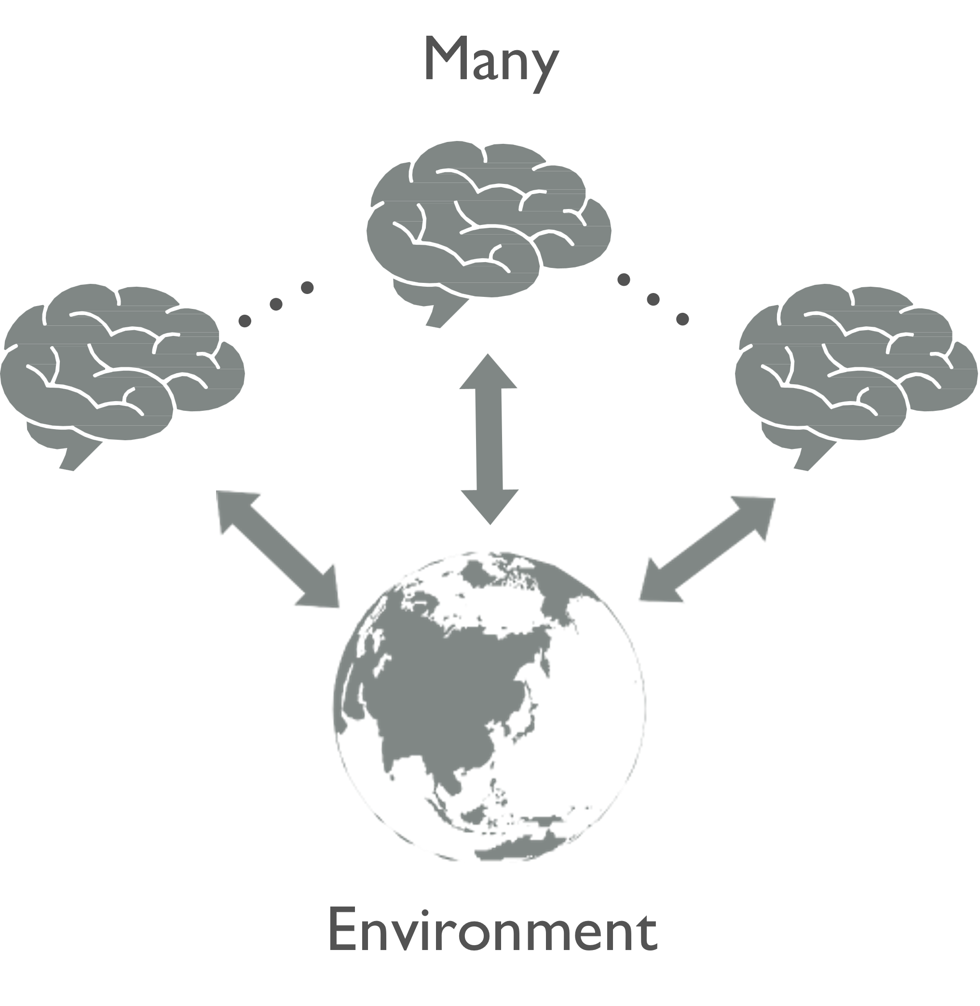
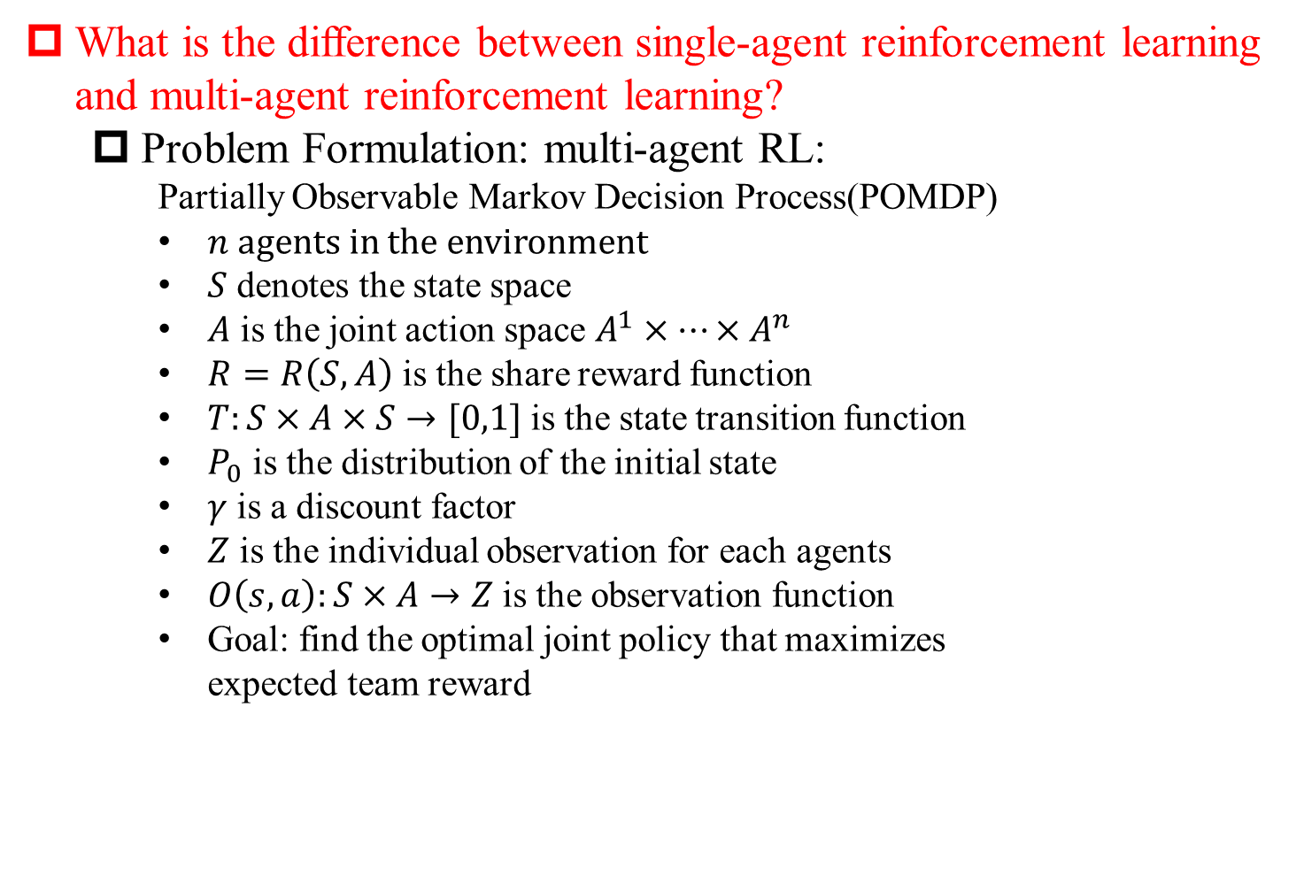
Multi-Agent RL
What is the difference between single-agent reinforcement learning and multi-agent reinforcement learning?
Problem Formulation: multi-agent RL:
Partially Observable Markov Decision Process(POMDP)
$n$ agents in the environment
$S$ denotes the state space
$A$ is the joint action space $A^{1}×…×A^{n}$
$R=R\left(S,A\right)$ is the share reward function
$T:S×A×S→[0,1]$ is the state transition function
$P_{0}$ is the distribution of the initial state
$γ$ is a discount factor
$Z$ is the individual observation for each agents
$O\left(s,a\right):S×A→Z$ is the observation function
Goal: find the optimal joint policy that maximizes expected team reward

Slide 11
Multi-Agent RL
What is the multi-agent reinforcement learning(MARL)?
What is the difference between single-agent reinforcement learning and multi-agent reinforcement learning?
What is the difficulty in the multi-agent reinforcement learning?
What are the categories of multi-agent reinforcement learning?

Slide 12
Multi-Agent RL
What is the difficulty in the multi-agent reinforcement learning?
Non-stationarity:
an agent observes not only the outcomes of its own action but also the behavior of other agents
Learning among the agents is complex because all agents potentially interact with each other and learn concurrently
Partial observability:
The agents only capture partial information about the environment before making decision
Dimension catastrophic:
Joint action space and Joint state space
Large-scale multi-agent decision-making、
Credit assignment:
Lazy agent
Sample efficiency、Exploration and Exploitation、complex mixed environment, etc.

Slide 13
Multi-Agent RL
What is the difficulty in the multi-agent reinforcement learning?
Solution
Non-stationarity:
Centralized Train and Decentralized execution(CTDE), e.g. MADDPG
Communication, e.g. CommNet
Partial observability:
RNN、GRU、LSTM, e.g. DRQN
Dimension catastrophic:
CTDE, e.g. VDN、QMIX
Mean-Field, e.g. MFAC
Credit assignment:
Counterfactual mechanisms, e.g. COMA
Exploration and Exploitation:
Reward shaping(intrinsic reward、novelty)
UCB
Influence(mutual information)

Slide 14
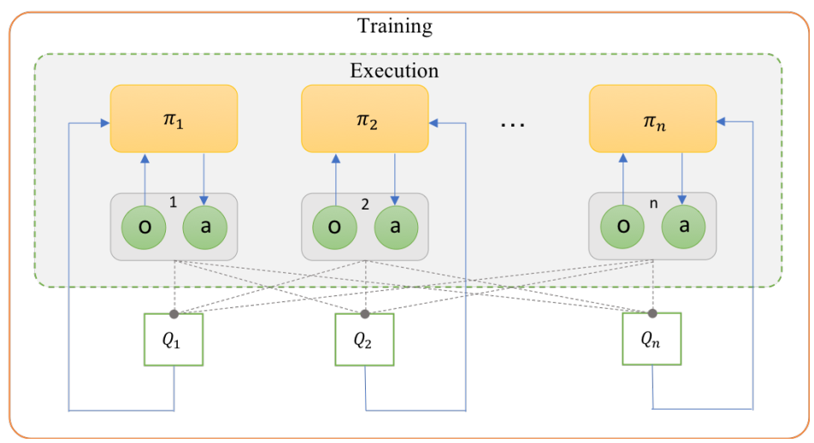
Multi-Agent RL
What is the difficulty in the multi-agent reinforcement learning?
Centralized Train and Decentralized execution(CTDE)

Slide 15
Multi-Agent RL
What is the multi-agent reinforcement learning(MARL)?
What is the difference between single-agent reinforcement learning and multi-agent reinforcement learning?
What is the difficulty in the multi-agent reinforcement learning?
What are the categories of multi-agent reinforcement learning?

Slide 16
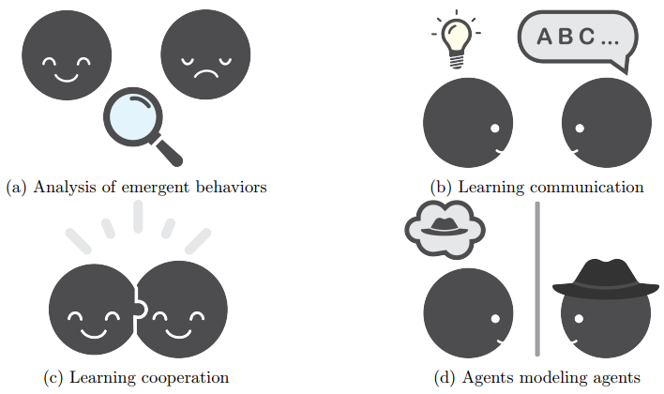
Multi-Agent RL
What are the categories of multi-agent reinforcement learning?
Analysis of emergent learning:
Simply using Single-agent RL algorithm in multi-agent scenarios
Learning communication:
Learning communication protocols among agents
Learning cooperation:
Learning to cooperate using only actions and local observation
Agents modeling agents:
Reasoning about others

Slide 17
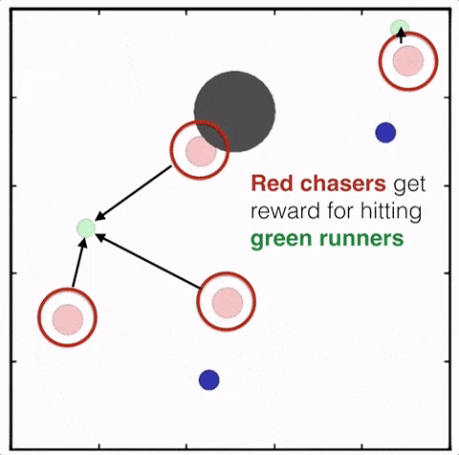
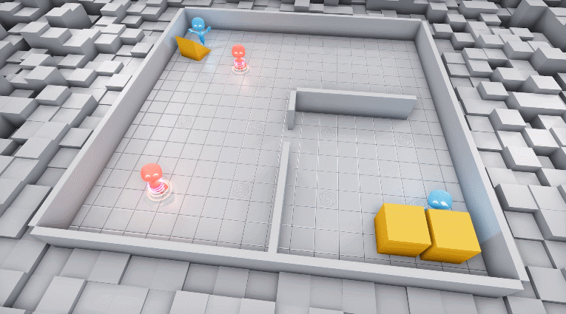
Multi-Agent RL
What are the types of multi-agent reinforcement learning?
Three major settings: cooperative, competitive, mixed scenarios
Cooperative：working together and coordinating their actions、maximizing a shared team reward
Competitive：self-interested(maximizing an individual reward)、opposite rewards、zero-sum games
Mixed scenarios：general-sum games

Slide 18
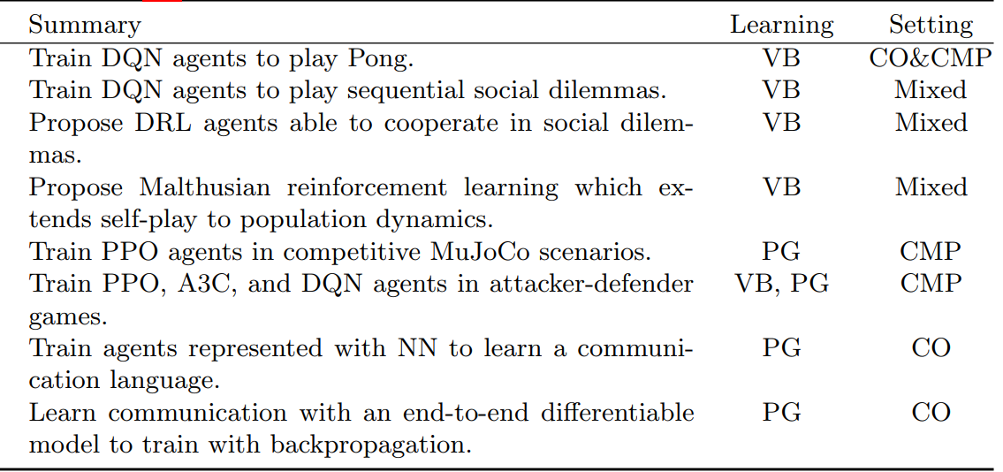
Multi-Agent RL
What are the types of multi-agent reinforcement learning?
Analysis of emergent learning:
These works, in general, do not propose learning algorithms—their main focus is to analyze and evaluate DRL algorithms, e.g., DQN, PPO and others, in a multiagent environment

Slide 19
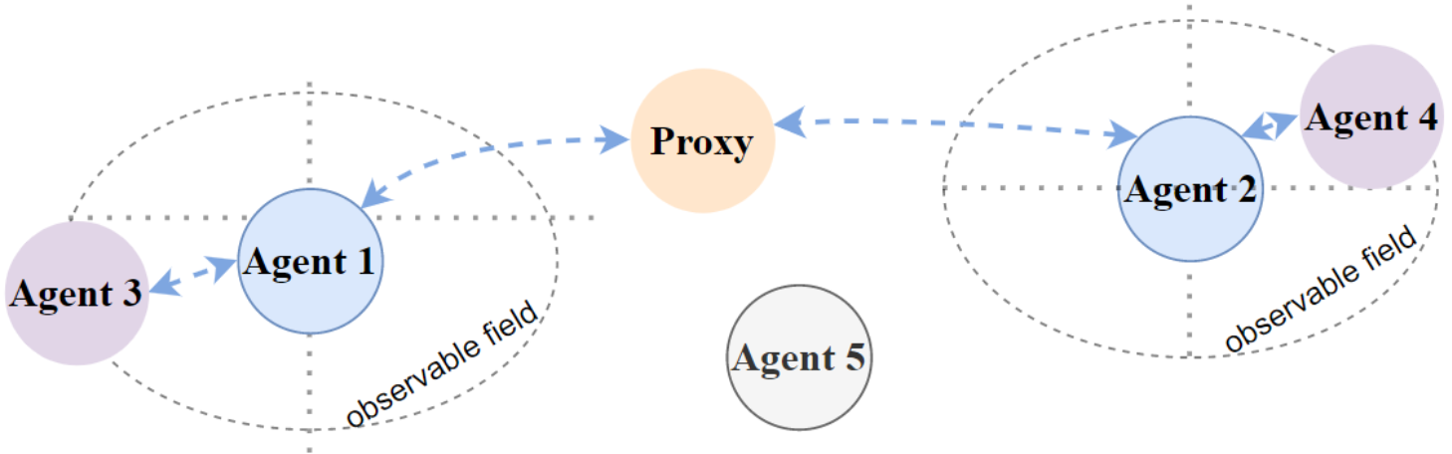
Multi-Agent RL
What are the types of multi-agent reinforcement learning?
Learning communication:
These works explore a sub-area in which agents can share information with communication protocols，for example through direct message or via a shared memory
This setting usually considers a set of cooperative agents in partially observable environment

Slide 20
Multi-Agent RL
What are the types of multi-agent reinforcement learning?
Learning communication—Dimensions and Targeted Problems
Dimensions | Targeted Problems
Communication Type | Which type of agents to communication with?
Communication Policy | When and how to build communication links among agent?
Communicated Messages | Which piece of information to share?
Message Combination | How to combine received messages?
Inner Integration | How to integrate combined message into learning models?
Communication Constraints | How to fulfill realistic requirements?
Communication learning | How to train and improve communication?
Training Scheme | How to utilize collected experience from agents?
Controlled Goals | What kind of behaviours are desired to emerge with communication?

Slide 21
Multi-Agent RL
What are the types of multi-agent reinforcement learning?
Learning communication—Communicatee Type
Types | Subtypes | Methods
Agents in the MAS: communicatees is composed of agents agent directly communicate with each other | Nearby Agents: Communication is only allowed between neighbors | DGN; MAGNet-SA-GS; Agent-Entity Graph; LSC; NeurComm; FlowComm; GAXNet
 | Other Agents: Nearby agents are not identified, the set of communicatees is simply composed of other agents | DIAL; RIAL; CommNet; BiCNet; TarMAC; MADDPG-M; IC3Net; DCC-MD; VBC; ETCNet; TMC
Proxy: A proxy is a visual agent who plays an essential role in communication, but does not have direct effect on the environment |  | MS-MARL-GCM; ATOC; MD-MADDPG; IMAC; GA-Comm; Gated-ACML; HAMMER; MAGIC

Slide 22
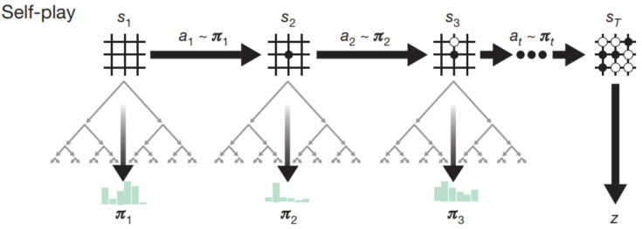
Multi-Agent RL
What are the types of multi-agent reinforcement learning?
Agents modeling agents :
An importance ability for agents to have is to reason about the behaviors of other agents by constructing models that make predictions about the modeled agents
Opponent model: utilizing network to learn a representation of the opponent’s policy or q-value, e.g., DRON; SOM
Self-play: agents learn to improve their performance by playing “against themselves”, e.g., NFSP; PSRO
Minimax: minimizing the worst case scenario (maximum loss), e.g., M3DDPG

Slide 23
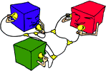
Multi-Agent RL
What are the types of multi-agent reinforcement learning?
Learning cooperation :
Open, dynamic, persistent systems
Decentralized control
Large scale
Partial observability
No real-time global reward signal
Communication delay

Slide 24
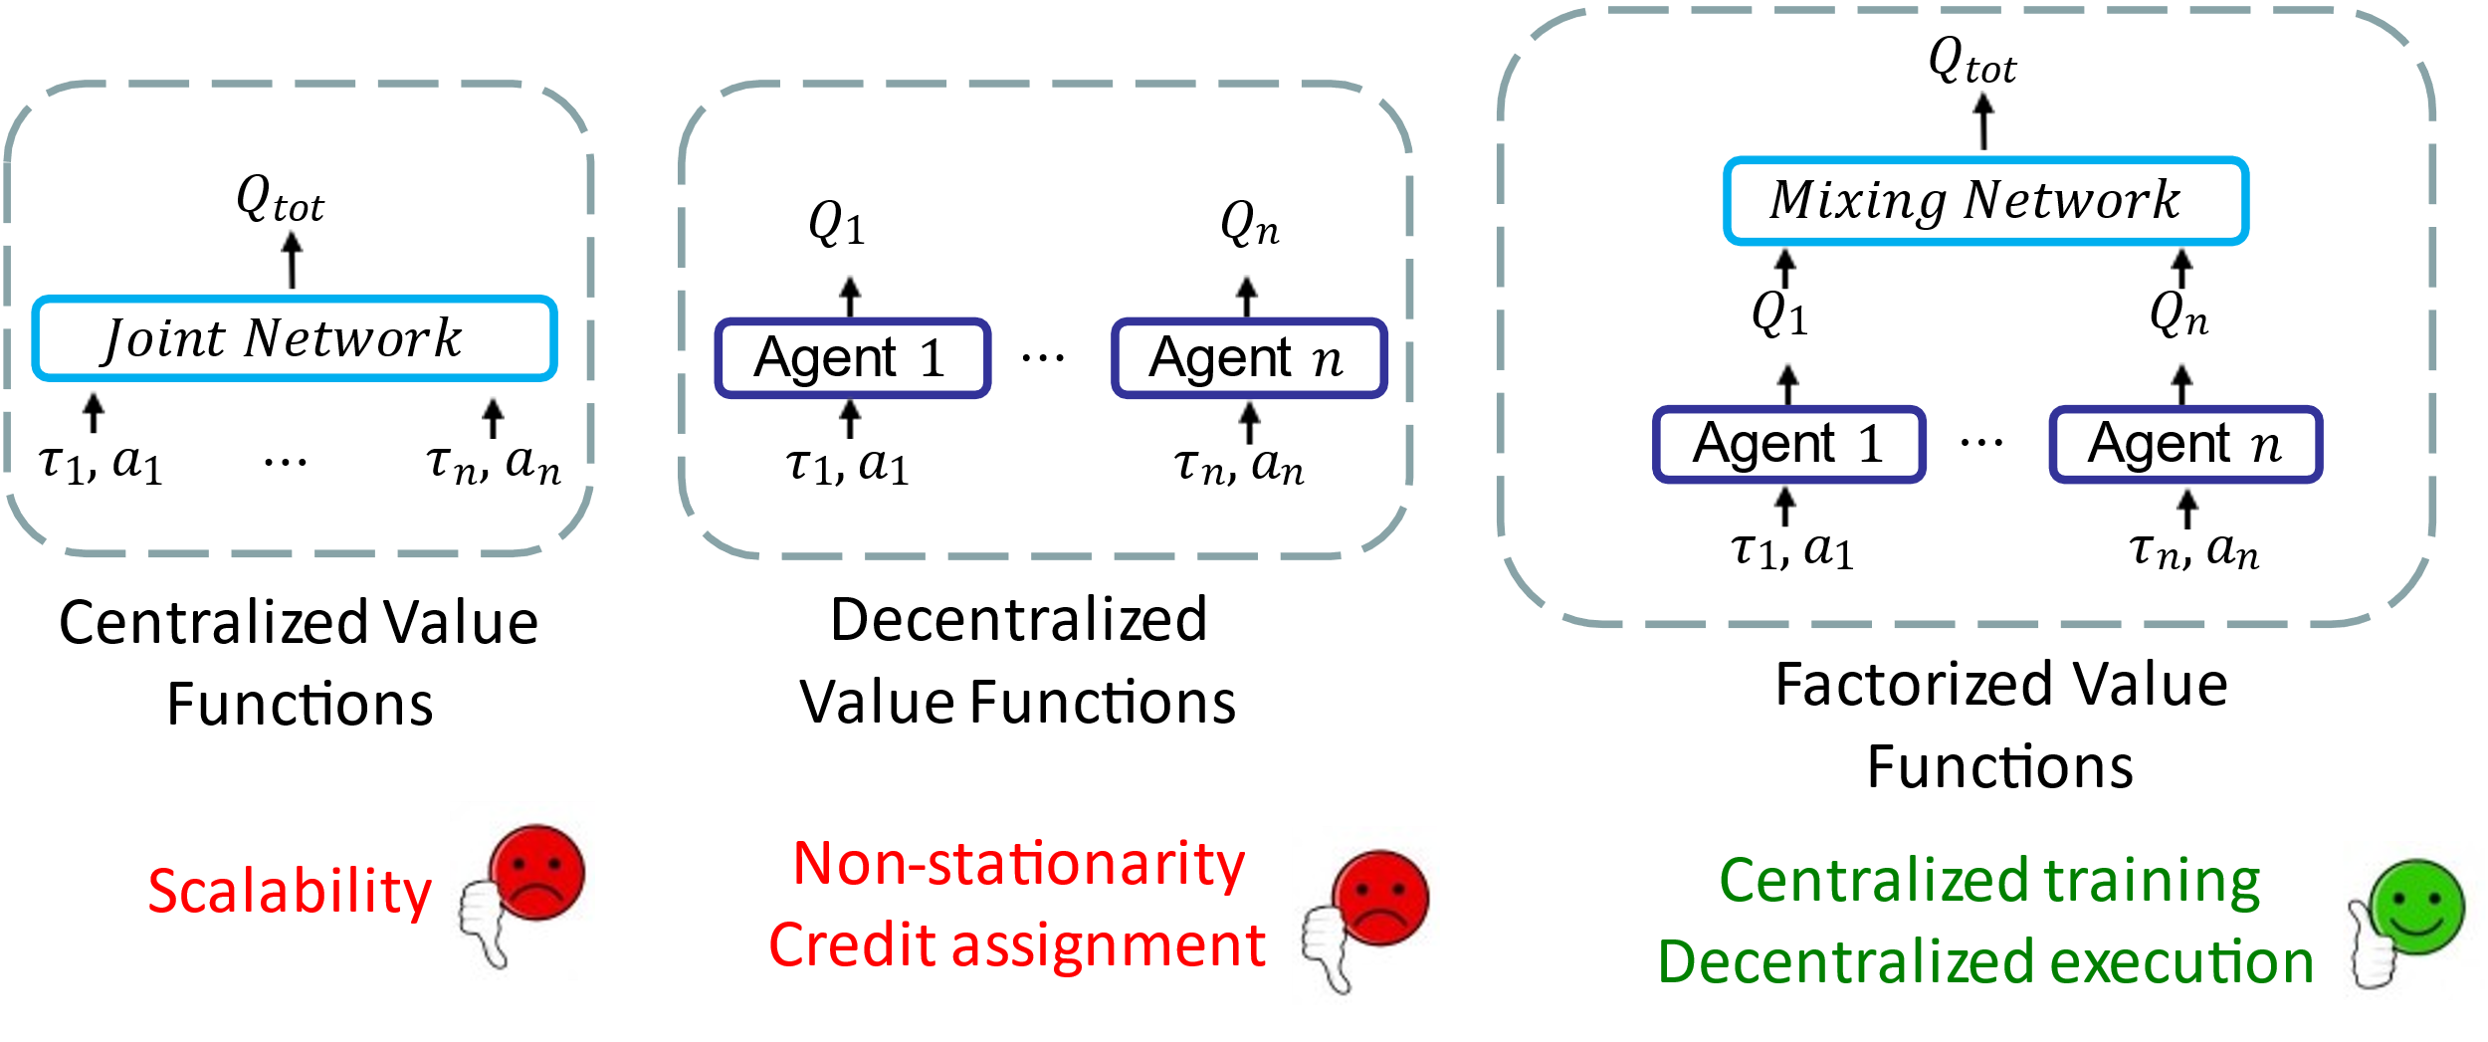
Multi-Agent RL
What are the types of multi-agent reinforcement learning?
Learning cooperation :
Value-Based Methods
Paradigm: CTDE
Methods: VDN, QMIX, QPLEX
Policy Gradient Methods
Paradigm: Centralized Critic and Decentralized Actors
Methods: MADDPG, COMA, DOP

Slide 25
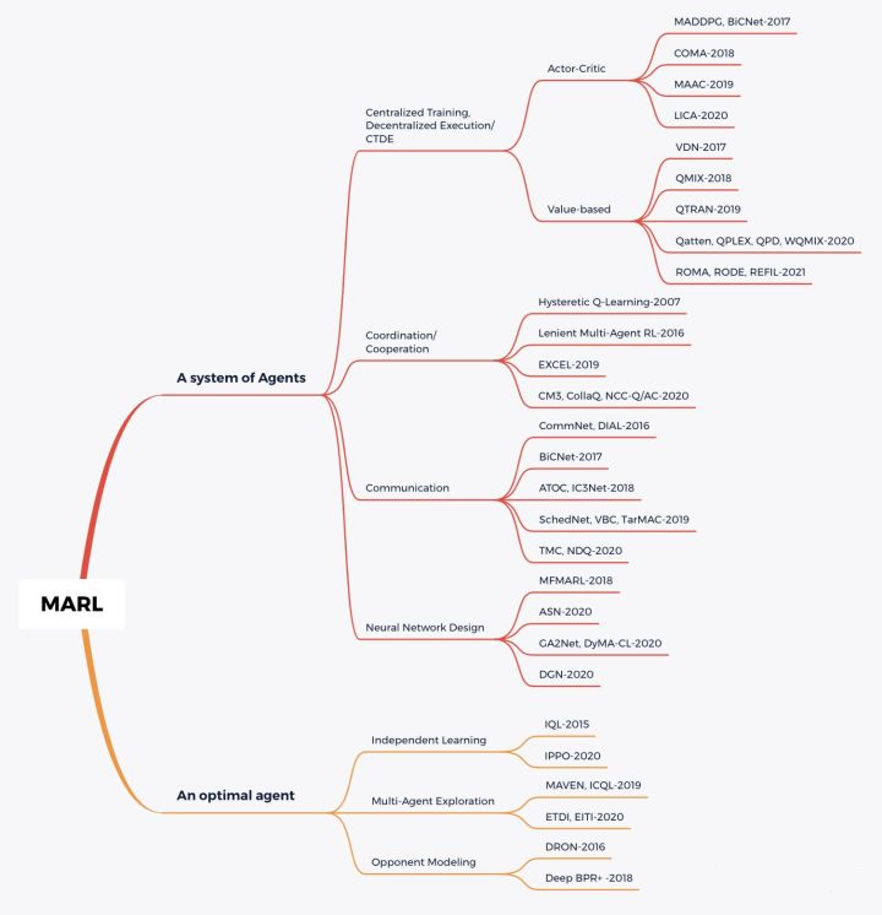
Multi-Agent RL
Summary

Slide 26
Multi-Agent RL
Independent Learning
IQL
IL with parameter sharing
Learning cooperation
MADDPG
COMA
VDN
QMIX

Slide 27
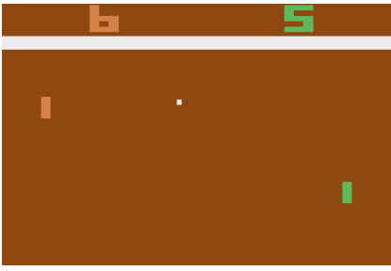
Multi-Agent RL
Independent Learning
Evaluate single-agent DRL algorithm in multiagent settings.
IQL
Study emergent cooperative and competitive strategies between multiple agents controlled by autonomous deep Q-Networks.
Use Atari video games as the environment.
Explore how two agents behave and interact in complex. environment when trained with different rewarding schemes.
Rewarding Schemes
Fully Competitive
Fully Cooperative
Transition between Cooperation and Competition
Tampuu, Ardi, et al. "Multiagent cooperation and competition with deep reinforcement learning." PloS one 12.4 (2017): e0172395.

Slide 28
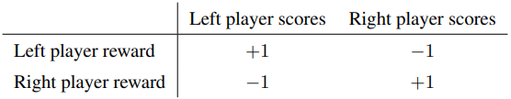
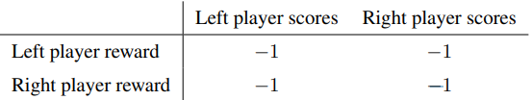
Multi-Agent RL
IQL
Score More than the Opponent (Fully Competitive)
The player who last touches the outgoing ball gets a plus point, and the player losing the ball a minus point.
Loosing the Ball Penalizes Both Players (Fully Cooperative)
Agents need to learn to keep the ball in the game for as long as possible.
Penalizing both of the players whenever the ball goes out of play.
Tampuu, Ardi, et al. "Multiagent cooperation and competition with deep reinforcement learning." PloS one 12.4 (2017): e0172395.

Slide 29
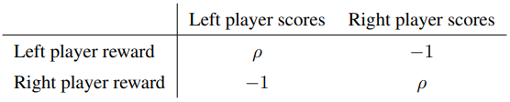
Multi-Agent RL
IQL
Transition Between Cooperation and Competition
The fully competitive and fully cooperative cases both penalize loosing the ball equally. What differentiates the two strategies are the values on the main diagonal of the reward matrix.
Allow this reward value $ρ$ to change gradually from -1 to +1
Three measures
Average paddle-bounces per point
Average wall-bounces per paddle-bounce
Average serving time per point
Tampuu, Ardi, et al. "Multiagent cooperation and competition with deep reinforcement learning." PloS one 12.4 (2017): e0172395.

Slide 30
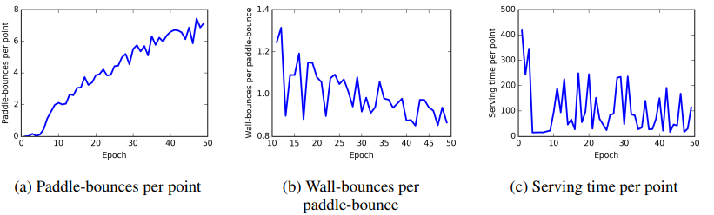
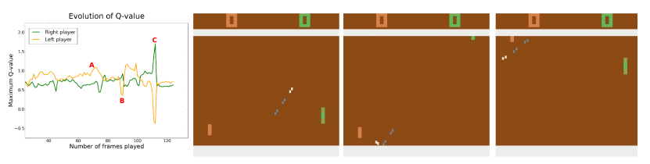
Multi-Agent RL
IQL
Result—Fully Competitive
Tampuu, Ardi, et al. "Multiagent cooperation and competition with deep reinforcement learning." PloS one 12.4 (2017): e0172395.

Slide 31
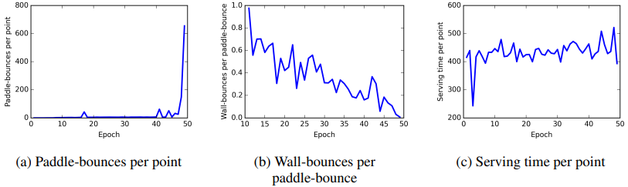
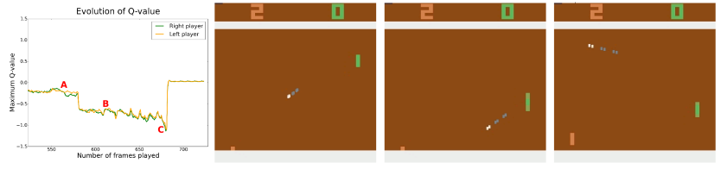
Multi-Agent RL
IQL
Result—Fully Cooperative
Tampuu, Ardi, et al. "Multiagent cooperation and competition with deep reinforcement learning." PloS one 12.4 (2017): e0172395.

Slide 32
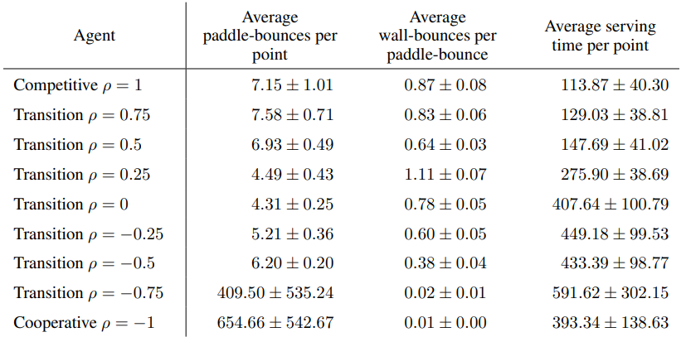
Multi-Agent RL
IQL
Result—Progression from Competition to Cooperation
Tampuu, Ardi, et al. "Multiagent cooperation and competition with deep reinforcement learning." PloS one 12.4 (2017): e0172395.

Slide 33
Multi-Agent RL
IL with parameter sharing
Dec-POMDPs.
Based on DQN, TRPO, DDPG, A3C
Three training schemes:
Centralized training and execution: a centralized policy maps the joint observation of all agents to a joint action
Concurrent training with decentralized execution: each agent learns its own individual policy.
Parameter sharing during training with decentralized execution: it allows the policy to be trained with the experiences of all agents simultaneously.
Gupta, Jayesh K., Maxim Egorov, and Mykel Kochenderfer. "Cooperative multi-agent control using deep reinforcement learning." International conference on autonomous agents and multiagent systems. Springer, Cham, 2017.

Slide 34
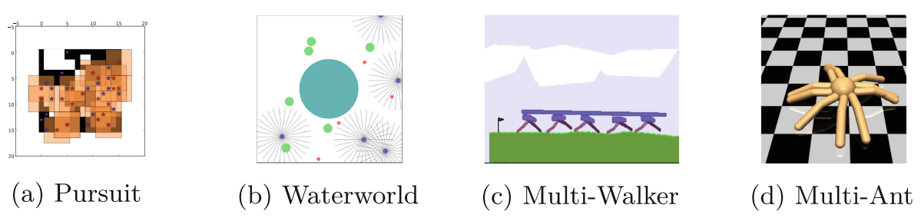
Multi-Agent RL
IL with parameter sharing
Four multi-agent benchmark tasks
Discrete: Pursuit
Continuous: Waterworld，Multi-Walker，Multi-Ant
Gupta, Jayesh K., Maxim Egorov, and Mykel Kochenderfer. "Cooperative multi-agent control using deep reinforcement learning." International conference on autonomous agents and multiagent systems. Springer, Cham, 2017.

Slide 35
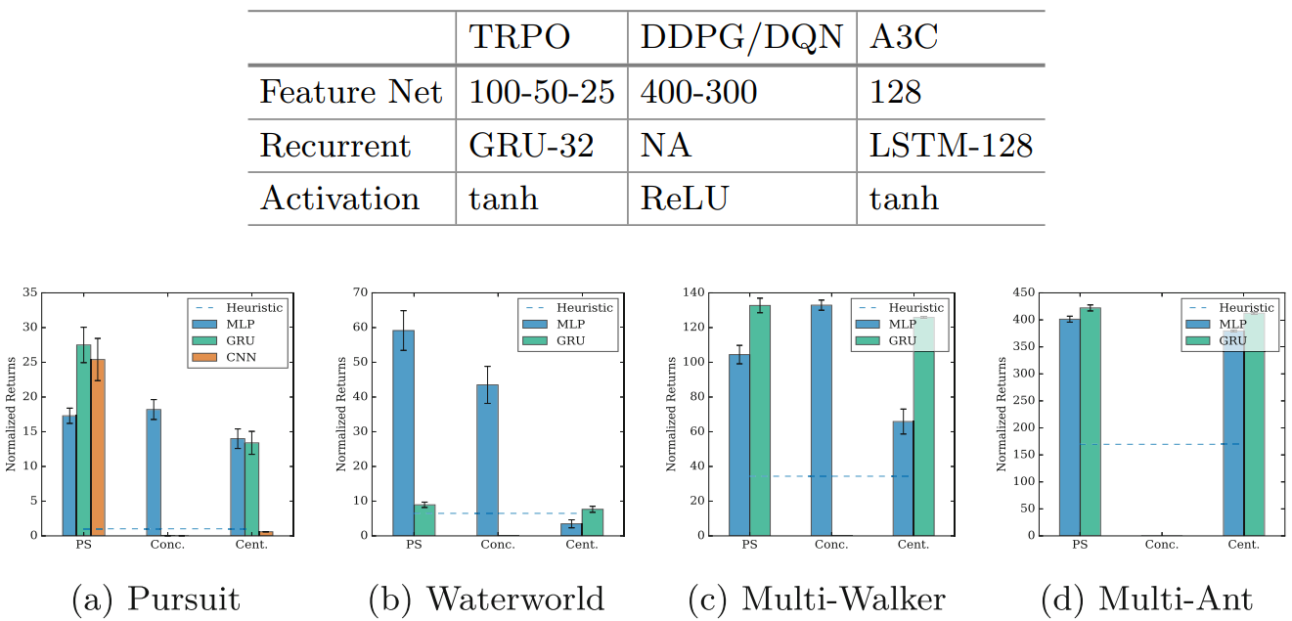
Multi-Agent RL
IL with parameter sharing
Result
Gupta, Jayesh K., Maxim Egorov, and Mykel Kochenderfer. "Cooperative multi-agent control using deep reinforcement learning." International conference on autonomous agents and multiagent systems. Springer, Cham, 2017.

Slide 36
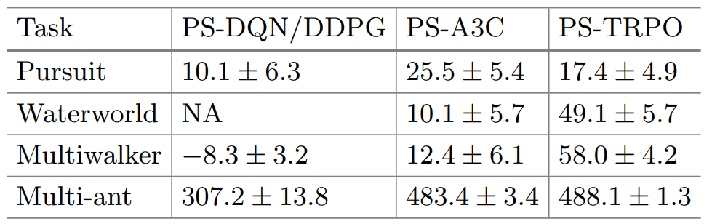
Multi-Agent RL
IL with parameter sharing
Result
Gupta, Jayesh K., Maxim Egorov, and Mykel Kochenderfer. "Cooperative multi-agent control using deep reinforcement learning." International conference on autonomous agents and multiagent systems. Springer, Cham, 2017.

Slide 37
Multi-Agent RL
Independent Learning
IQL
IL with parameter sharing
Learning cooperation
MADDPG
COMA
VDN
QMIX

Slide 38
Multi-Agent RL
Centralized Train and Decentralized execution(CTDE)

Slide 39
Multi-Agent RL
MADDPG
Challenge
Non-stationarity of the environment
Policy gradient suffers from a variance that increases as the number of agents grows
Main idea
Leads to learned policies that only use local information at execution time and allow the policies to use extra information to ease training
Does not assume a differentiable model of the environment dynamics or any particular structure on the communication method between agents
Is applicable not only to cooperative interaction but to competitive or mixed interaction involving both physical and communicative behavior
Lowe, Ryan, et al. "Multi-agent actor-critic for mixed cooperative-competitive environments." Advances in neural information processing systems 30 (2017).

Slide 40
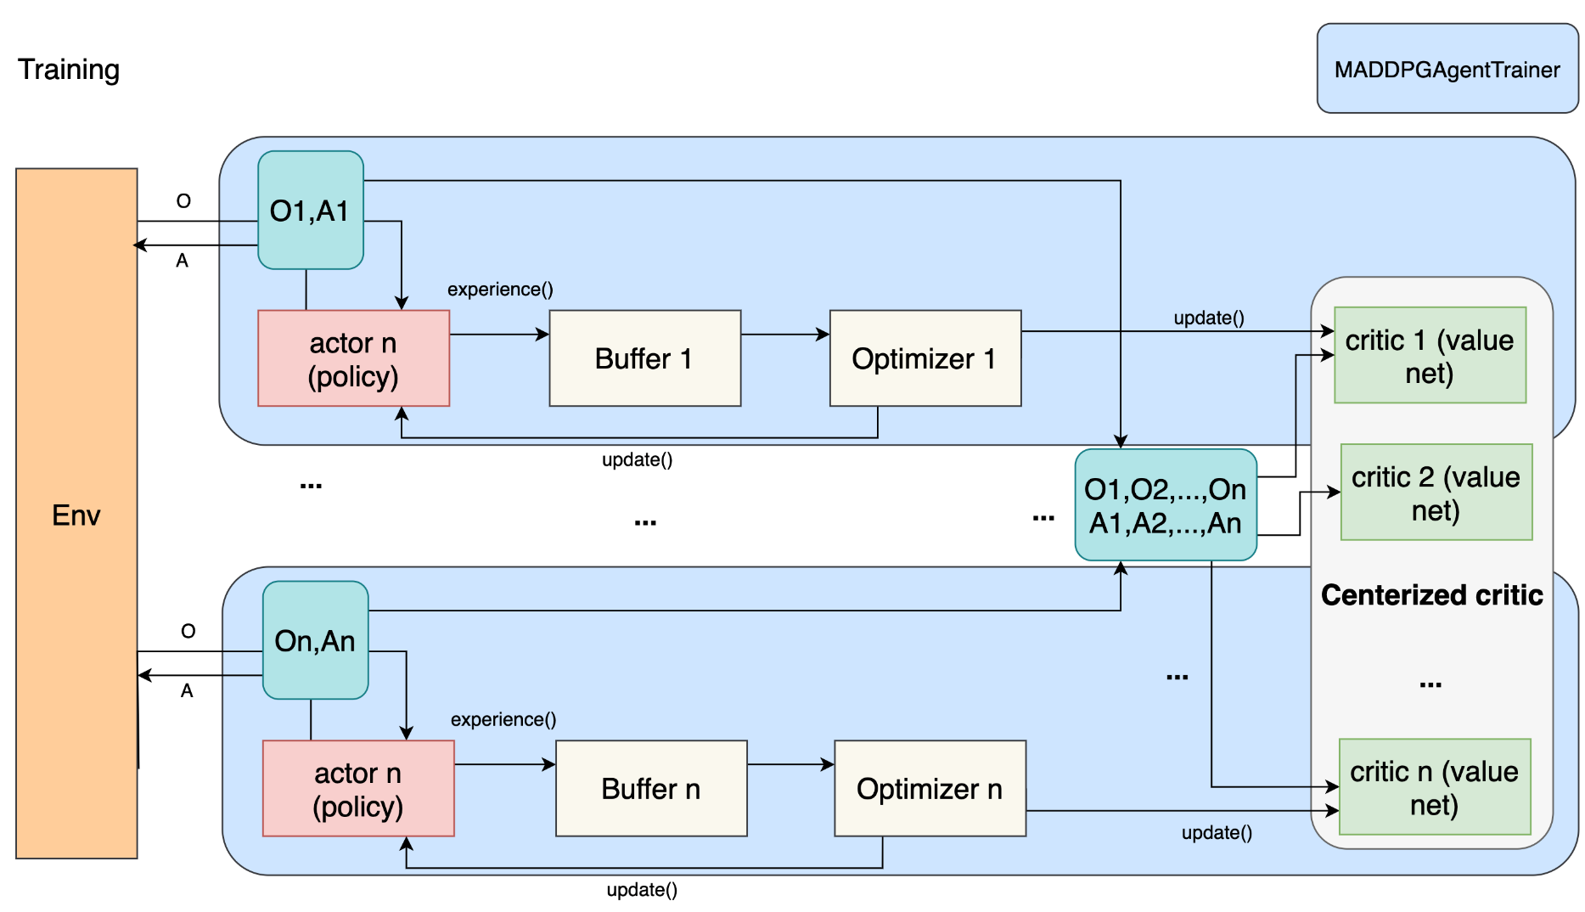
Multi-Agent RL
MADDPG
Simple extension of actor-critic policy gradient methods where critic is augmented with extra information about the policies of other agents, while the actor only has access to local information

Slide 41
Multi-Agent RL
MADDPG
The gradient of the expected return for agent $i$:
Deterministic policies:
Lowe, Ryan, et al. "Multi-agent actor-critic for mixed cooperative-competitive environments." Advances in neural information processing systems 30 (2017).

Slide 42
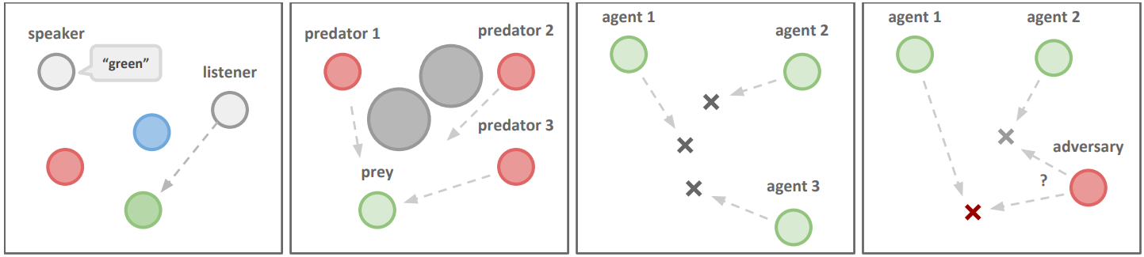
Multi-Agent RL
MADDPG
Multiagent-particle-environment
Cooperative Communication
Predator-Prey
Cooperative Navigation
Physical Deception
The environments are publicly available: https://github.com/openai/multiagent-particle-envs
Lowe, Ryan, et al. "Multi-agent actor-critic for mixed cooperative-competitive environments." Advances in neural information processing systems 30 (2017).

Slide 43
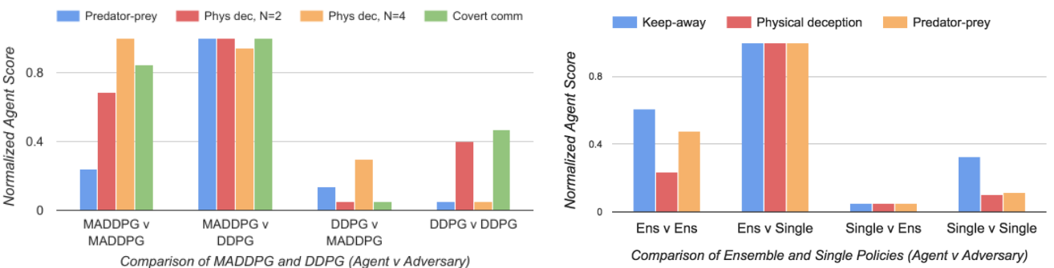
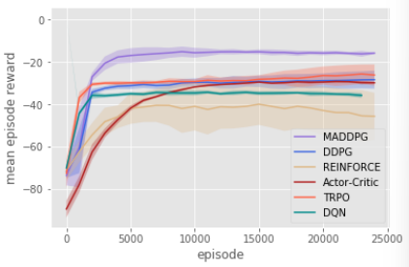
Multi-Agent RL
MADDPG
Performance
Lowe, Ryan, et al. "Multi-agent actor-critic for mixed cooperative-competitive environments." Advances in neural information processing systems 30 (2017).

Slide 44
Multi-Agent RL
COMA
Challenge
Credit assignment: in cooperative settings, joint actions typically generate only global rewards, making it difficult for each agent to deduce its own contribution to the team’s success.
Main idea
Use CTDE as same as MADDPG
Counterfactual: Use a counterfactual baseline that marginalizes out a single agent’s action
Using the centralized critic to compute an agent-specific advantage function that compares the estimated return for the current joint action to a counterfactual baseline that marginalizes out a single agent’s action, while keeping the other agent’s actions fixed
Uses a critic representation that allows the counterfactual baseline to be computed efficiently.
Foerster, Jakob, et al. "Counterfactual multi-agent policy gradients." Proceedings of the AAAI conference on artificial intelligence. Vol. 32. No. 1. 2018.

Slide 45
Multi-Agent RL
COMA
Advantage function：
COMA gradient：
Foerster, Jakob, et al. "Counterfactual multi-agent policy gradients." Proceedings of the AAAI conference on artificial intelligence. Vol. 32. No. 1. 2018.

Slide 46
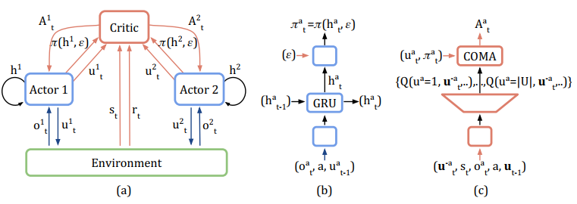
Multi-Agent RL
COMA
COMA gradient：
Foerster, Jakob, et al. "Counterfactual multi-agent policy gradients." Proceedings of the AAAI conference on artificial intelligence. Vol. 32. No. 1. 2018.

Slide 47
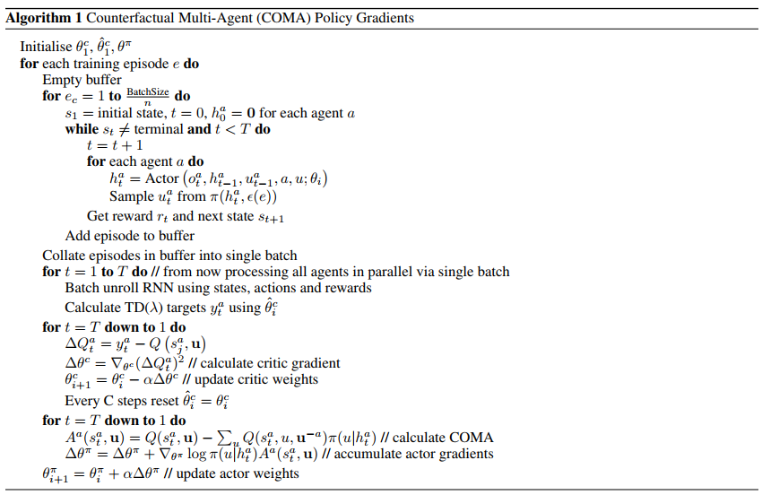
Multi-Agent RL
COMA
Foerster, Jakob, et al. "Counterfactual multi-agent policy gradients." Proceedings of the AAAI conference on artificial intelligence. Vol. 32. No. 1. 2018.

Slide 48
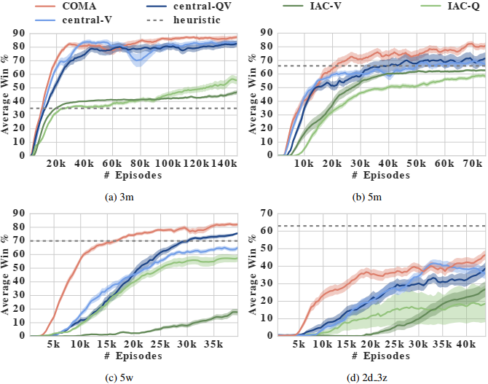
Multi-Agent RL
COMA
Performance
Foerster, Jakob, et al. "Counterfactual multi-agent policy gradients." Proceedings of the AAAI conference on artificial intelligence. Vol. 32. No. 1. 2018.

Slide 49
Multi-Agent RL
VDN
Challenge
Lazy agent: one agent learns a useful policy, but a second agent is discouraged from learning because its exploration would hinder the first agent and lead to worse team reward.
Large-scale multi-agent scenarios.
Main idea
Training individual agents with a novel value decomposition network architecture, which learns to decompose the team value function into agent-wise value functions
The value decomposition network aims to learn an optimal linear value decomposition from the team reward signal, by back-propagating the total Q gradient through deep neural networks representing the individual component value functions.
Sunehag, Peter, et al. "Value-decomposition networks for cooperative multi-agent learning." arXiv preprint arXiv:1706.05296 (2017).

Slide 50
Multi-Agent RL
VDN
Joint action-value function can be additively decomposed into value functions across agents
Consider the case with two agents and where rewards decompose additively across agent observations,
When agents store additional information from historical observation
Sunehag, Peter, et al. "Value-decomposition networks for cooperative multi-agent learning." arXiv preprint arXiv:1706.05296 (2017).

Slide 51
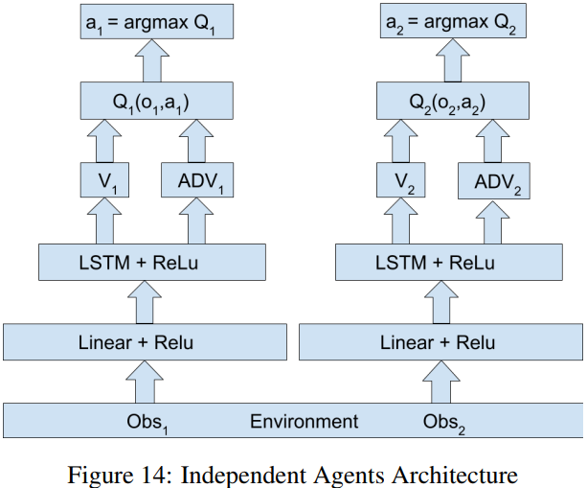
Multi-Agent RL
VDN
Architecture
IL
Sunehag, Peter, et al. "Value-decomposition networks for cooperative multi-agent learning." arXiv preprint arXiv:1706.05296 (2017).

Slide 52
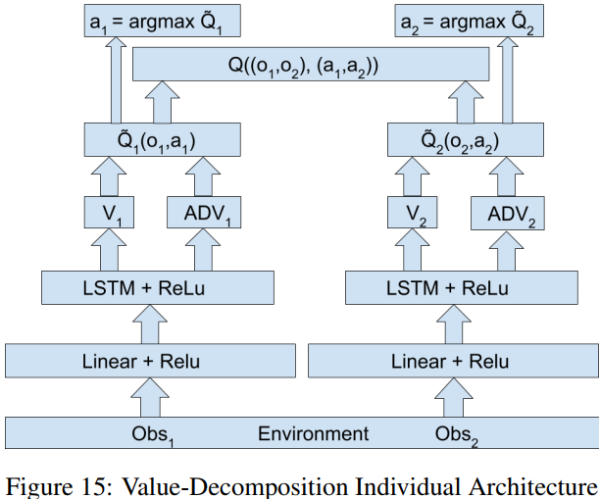
Multi-Agent RL
VDN
Architecture
VDN
Sunehag, Peter, et al. "Value-decomposition networks for cooperative multi-agent learning." arXiv preprint arXiv:1706.05296 (2017).

Slide 53
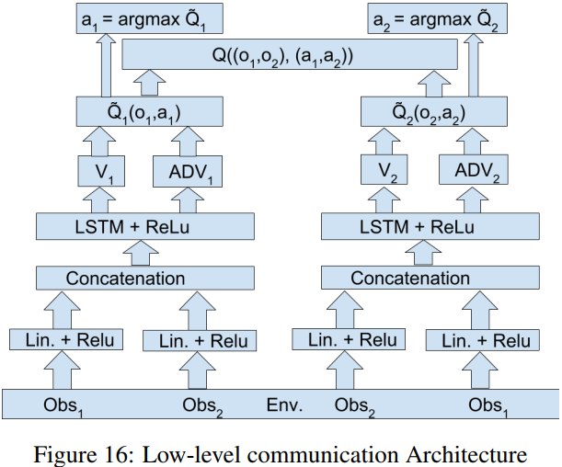
Multi-Agent RL
VDN
Architecture
VDN+Comm
Sunehag, Peter, et al. "Value-decomposition networks for cooperative multi-agent learning." arXiv preprint arXiv:1706.05296 (2017).

Slide 54
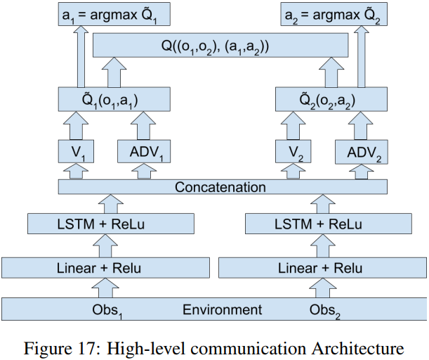
Multi-Agent RL
VDN
Architecture
VDN+Comm
Sunehag, Peter, et al. "Value-decomposition networks for cooperative multi-agent learning." arXiv preprint arXiv:1706.05296 (2017).

Slide 55
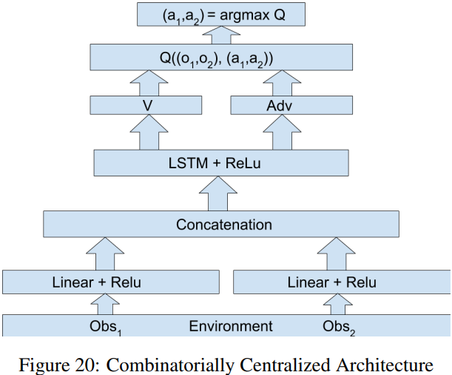
Multi-Agent RL
VDN
Architecture
Centralized
Sunehag, Peter, et al. "Value-decomposition networks for cooperative multi-agent learning." arXiv preprint arXiv:1706.05296 (2017).

Slide 56
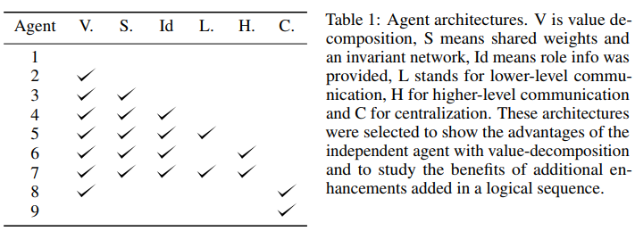
Multi-Agent RL
VDN
Performance
Sunehag, Peter, et al. "Value-decomposition networks for cooperative multi-agent learning." arXiv preprint arXiv:1706.05296 (2017).

Slide 57
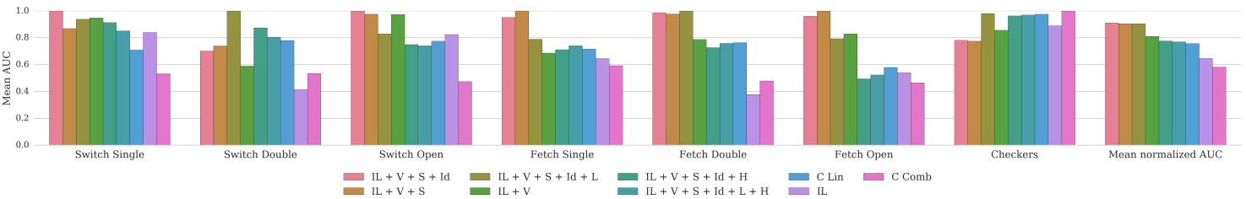
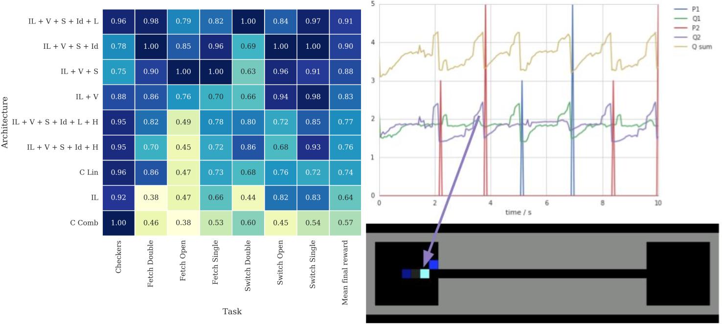
Multi-Agent RL
VDN
Performance
Sunehag, Peter, et al. "Value-decomposition networks for cooperative multi-agent learning." arXiv preprint arXiv:1706.05296 (2017).

Slide 58
Multi-Agent RL
QMIX
Main idea
Employ a network that estimates joint action-values as a complex non-linear combination of per-agent values that condition only on local observations
Ensure that a global argmax performed on $Q_{tot}$ yields the same result as a set of individual argmax operations performed on each $Q_{a}$
Enforce a monotonicity constraint on the relationship between $Q_{tot}$ and each $Q_{a}$
Rashid, Tabish, et al. "Qmix: Monotonic value function factorisation for deep multi-agent reinforcement learning." International Conference on Machine Learning. PMLR, 2018.

Slide 59
Multi-Agent RL
QMIX
Main idea
Enforce a monotonicity constraint on the relationship between $Q_{tot}$ and each $Q_{a}$
Represent $Q_{tot}$using an architecture consisting of agent networks, a mixing network, and a set of hypernetworks.
Restrict the mixing network to have positive weights
The weights of the mixing network are produced by separate hypernetworks.
Each hypernetwork takes the state $s$ as input and generates the weights of one layer of the mixing network. Each hypernetwork consists of a single linear layer, followed by an absolute activation function, to ensure that the mixing network weights are non-negative.
Rashid, Tabish, et al. "Qmix: Monotonic value function factorisation for deep multi-agent reinforcement learning." International Conference on Machine Learning. PMLR, 2018.

Slide 60
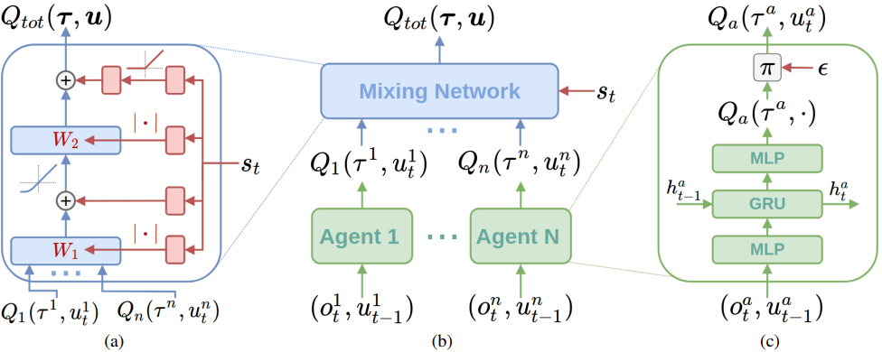
Multi-Agent RL
QMIX
Architecture
Loss
Rashid, Tabish, et al. "Qmix: Monotonic value function factorisation for deep multi-agent reinforcement learning." International Conference on Machine Learning. PMLR, 2018.

Slide 61
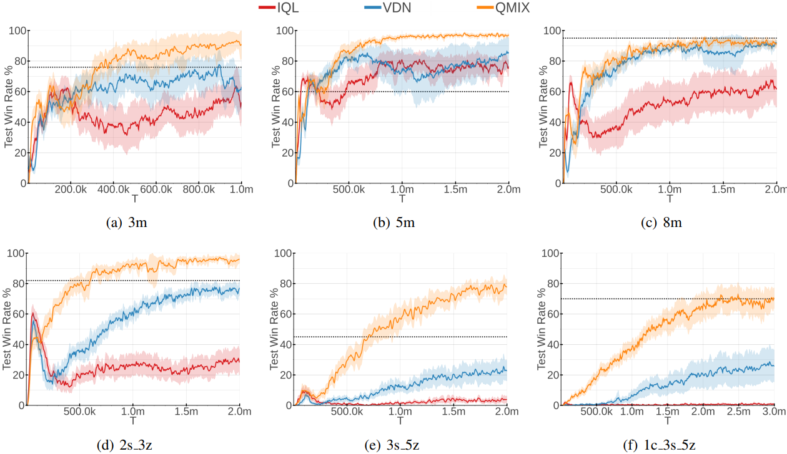
Multi-Agent RL
QMIX
Performance
Rashid, Tabish, et al. "Qmix: Monotonic value function factorisation for deep multi-agent reinforcement learning." International Conference on Machine Learning. PMLR, 2018.

Slide 62
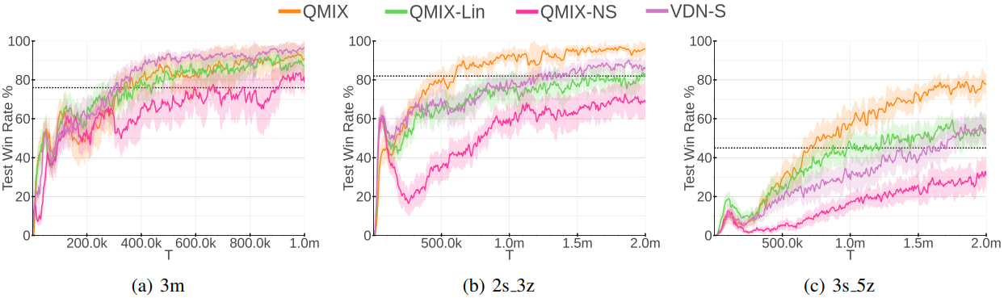
Multi-Agent RL
QMIX
Performance
QMIX-NS: the weights and biases of the mixing network are learned in the standard way, without conditioning on the state
QMIX-LIN: remove the hidden layer of the mixing network
VDN-S: add a state-dependent term to the sum of the agent’s Q-values
Rashid, Tabish, et al. "Qmix: Monotonic value function factorisation for deep multi-agent reinforcement learning." International Conference on Machine Learning. PMLR, 2018.

Slide 63
Multi-Agent RL
Learning cooperation
MAPPO
COPPO
EOI
TarMAC

Slide 64
Multi-Agent RL
MAPPO
On-policy and Off-policy
On-policy: the experiences are collected using the latest learned policy, and then using that experience to improve the policy.
Off-policy learning allows the use of older samples(collected using the older policies) in the calculation.
On-policy RL algorithms are significantly less sample efficient than off-policy methods.
Main contributions
Multi-Agent PPO(MAPPO), with minimal hyperparameter tuning and without any domain-specific algorithmic changes or architectures, achieves final performances comparable to various off-policy methods
MAPPO obtains these strong results while often using a comparable number of samples to many off-policy methods
Five implementation and algorithmic factors that govern the practical performance of MAPPO
Yu, Chao, et al. "The Surprising Effectiveness of PPO in Cooperative, Multi-Agent Games." arXiv preprint arXiv:2103.01955 (2021).

Slide 65
Multi-Agent RL
MAPPO
Component
Following the CTDE structure: following the algorithmic structure of the single-agent PPO algorithm by learning a policy $π_{θ}$ and a value function $V_{φ}(s)$ which can take extra global information.
Generalized Advantage Estimation(GAE)
Advantage normalization
Observation normalization
Gradient clipping
Value clipping
Layer normalization
ReLU activation with orthogonal initialization
Large batch size
Five concrete implementation details which are insightful and particularly critical to MAPPO’s practical performance: value normalization, value function inputs, training data usage, policy and value clipping, death masking.
Yu, Chao, et al. "The Surprising Effectiveness of PPO in Cooperative, Multi-Agent Games." arXiv preprint arXiv:2103.01955 (2021).

Slide 66
Multi-Agent RL
MAPPO
Value Normalization
To stabilize value learning
Standardize the targets of the value function by using running estimates of the average and standard deviation of the value targets
Conclusion: using value normalization never hurts training and often significantly improves the final performance of MAPPO
Training Data Usage
A major trick in PPO is the use of importance sampling to perform off-policy corrections, allowing for sample reuse.
MAPPO’s performance degrades when samples are re-used too often.
Conclusion: avoid using too many training epochs and do not split data into mini-batches.
Yu, Chao, et al. "The Surprising Effectiveness of PPO in Cooperative, Multi-Agent Games." arXiv preprint arXiv:2103.01955 (2021).

Slide 67
Multi-Agent RL
MAPPO
Input Representation to Value Function
Two common implementations for a centralized value function: concatenation of all local observations, an environment-provided global state. Other methods: agent-specific global state representation.
Concatenation of all local observations(CL) :
the value input dimension can be extremely large when the number of agent or the dimension of local observation is large.
CL also may not contain sufficient global information to reduce a POMDP to an MDP.
Environment-provided global state(EP): Only contains information common to all agents and can omit important local information
Agent-Specific Global State(AS): concatenate the environment state and the local observation
Feature-Pruned Agent-Specific Global State(FP): to address the overlap between local and global state, removing all the duplicated features in AS.
Yu, Chao, et al. "The Surprising Effectiveness of PPO in Cooperative, Multi-Agent Games." arXiv preprint arXiv:2103.01955 (2021).

Slide 68

Multi-Agent RL
MAPPO
Input Representation to Value Function
IND: using decentralized inputs
EP: using environment-provided global state
AS: agent-specific global state which concatenates EP and IND
FP: removing the duplicated features in AS
Conclusion: include agent-specific features in the global state and check that these features do not make the state dimension substantially higher
Yu, Chao, et al. "The Surprising Effectiveness of PPO in Cooperative, Multi-Agent Games." arXiv preprint arXiv:2103.01955 (2021).

Slide 69

Multi-Agent RL
MAPPO
PPO Clipping
Clipping the importance ratio and value losses
Constrain the policy and value functions from drastically changing between iterations
$ε$ hyperparameter: lower $ε$ values slows learning speed and higher $ε$ values result in larger variance and larger volatility in the performance
Conclusion: tuning the clipping ratio $ε$ as a trade-off between training stability and fast convergence
Death Masking
Using these informative states for dead agents during value learning amplifies the bias of the learned value function
Using an agent-specific constant vector, i.e., a zero vector with the agent’s ID, as the input to the value function after an agent dies.
Conclusion: use zero states with agent ID as the value input for dead agents.
Yu, Chao, et al. "The Surprising Effectiveness of PPO in Cooperative, Multi-Agent Games." arXiv preprint arXiv:2103.01955 (2021).

Slide 70

Multi-Agent RL
MAPPO
Yu, Chao, et al. "The Surprising Effectiveness of PPO in Cooperative, Multi-Agent Games." arXiv preprint arXiv:2103.01955 (2021).

Slide 71

Multi-Agent RL
MAPPO
Main Results
Four multi-agent testbeds: MPE, SC2, Hanabi, Google football
Yu, Chao, et al. "The Surprising Effectiveness of PPO in Cooperative, Multi-Agent Games." arXiv preprint arXiv:2103.01955 (2021).

Slide 72


Multi-Agent RL
MAPPO
Main Results
Yu, Chao, et al. "The Surprising Effectiveness of PPO in Cooperative, Multi-Agent Games." arXiv preprint arXiv:2103.01955 (2021).

Slide 73

Multi-Agent RL
MAPPO
Main Results
Yu, Chao, et al. "The Surprising Effectiveness of PPO in Cooperative, Multi-Agent Games." arXiv preprint arXiv:2103.01955 (2021).

Slide 74

Multi-Agent RL
MAPPO
Main Results
Yu, Chao, et al. "The Surprising Effectiveness of PPO in Cooperative, Multi-Agent Games." arXiv preprint arXiv:2103.01955 (2021).

Slide 75



Multi-Agent RL
MAPPO
Main Results--Ablation
Yu, Chao, et al. "The Surprising Effectiveness of PPO in Cooperative, Multi-Agent Games." arXiv preprint arXiv:2103.01955 (2021).

Slide 76

Multi-Agent RL
MAPPO
Main Results--Ablation
Yu, Chao, et al. "The Surprising Effectiveness of PPO in Cooperative, Multi-Agent Games." arXiv preprint arXiv:2103.01955 (2021).

Slide 77


Multi-Agent RL
MAPPO
Main Results--Ablation
Yu, Chao, et al. "The Surprising Effectiveness of PPO in Cooperative, Multi-Agent Games." arXiv preprint arXiv:2103.01955 (2021).

Slide 78

Multi-Agent RL
COPPO
Motivation
Many cooperative multi-agent reinforcement learning algorithms coordinate the agents using a paradigm called Centralized Training with Decentralized Execution (CTDE). In this paradigm, the update of value-based (1) and policy-based (2) methods can be formulated as follows respectively, without loss of generality:
COPPO directly coordinates over the agents’ policies by dynamically adapting the step sizes during the agents’ policy update processes
Wu, Zifan, et al. "Coordinated proximal policy optimization." Advances in Neural Information Processing Systems 34 (2021): 26437-26448.

Slide 79
Multi-Agent RL
COPPO
Main contributions
CoPPO first proves a relationship between a lower bound of joint policy performance and the update of policies. Based on this relationship, a monotonic joint policy improvement can be achieved through optimizing an ideal objective
To improve scalability and credit assignment, and to cope with the potential high variance due to non-stationarity, a series of transformations and approximations are then conducted to derive an implementable optimization objective in the final CoPPO algorithm
While originally aiming at monotonic joint policy improvement, CoPPO ultimately realizes a direct coordination over the policies at the level of each agent’s policy update step size. Concretely, by taking other agents’ policy update into consideration, CoPPO is able to achieve dynamic credit assignment that helps to indicate a proper update step size to each agent during the optimization procedure
Wu, Zifan, et al. "Coordinated proximal policy optimization." Advances in Neural Information Processing Systems 34 (2021): 26437-26448.

Slide 80

Multi-Agent RL
COPPO
Components
Wu, Zifan, et al. "Coordinated proximal policy optimization." Advances in Neural Information Processing Systems 34 (2021): 26437-26448.

Slide 81

Multi-Agent RL
COPPO
Components
Wu, Zifan, et al. "Coordinated proximal policy optimization." Advances in Neural Information Processing Systems 34 (2021): 26437-26448.

Slide 82

Multi-Agent RL
COPPO
Components
Wu, Zifan, et al. "Coordinated proximal policy optimization." Advances in Neural Information Processing Systems 34 (2021): 26437-26448.

Slide 83

Multi-Agent RL
COPPO
Components
Wu, Zifan, et al. "Coordinated proximal policy optimization." Advances in Neural Information Processing Systems 34 (2021): 26437-26448.

Slide 84

Multi-Agent RL
COPPO
Experiments
Wu, Zifan, et al. "Coordinated proximal policy optimization." Advances in Neural Information Processing Systems 34 (2021): 26437-26448.

Slide 85

Multi-Agent RL
COPPO
Experiments
Wu, Zifan, et al. "Coordinated proximal policy optimization." Advances in Neural Information Processing Systems 34 (2021): 26437-26448.

Slide 86
Multi-Agent RL
EOI
Cheap Reward
Agents all tend to track the easy object for the cheap reward
Similar behavior can easily make the learned policies fall into local optimally
Individuality
Agents can respectively track different objects
Automatically driving agents to behave differently and take a variety of roles to complete tasks successfully
Jiang, Jiechuan, and Zongqing Lu. "The emergence of individuality." International Conference on Machine Learning. PMLR, 2021.

Slide 87
Multi-Agent RL
EOI
Main contributions
Emergence Of Individuality（EOI）
Learn a probabilistic classifier that predicts a probability over agents given their observation
Give each agent an intrinsic reward of being correctly predicted probability by the classifier.
Tend to visit their own familiar observations
Two Regularizer
Observation visited by different agents cannot be easily distinguished by the classifier
Positive Distance（PD）
Mutual Information（MI）
Jiang, Jiechuan, and Zongqing Lu. "The emergence of individuality." International Conference on Machine Learning. PMLR, 2021.

Slide 88


Multi-Agent RL
EOI
Emergence of individuality(EOI)
Learn a probabilistic classifier $P(I|O)$
Each agent takes the correctly predicted probability as the intrinsic reward at each timestep $r_{local}=r_{env}+ αp(i|o_{i})$
If there is initial difference between agent policies in terms of visited observations, the difference is captured by $P(I|O)$ as it then fed back to each agent as an intrinsic reward. As agents maximize the expected return, the difference in agents’ policies is exacerbated together with optimizing the environmental return. As agents progressively behave more identifiably, the classifier can distinguish agents more accurately, and thus individuality emerges gradually.
Jiang, Jiechuan, and Zongqing Lu. "The emergence of individuality." International Conference on Machine Learning. PMLR, 2021.

Slide 89

Multi-Agent RL
EOI
Regularizers of $P_{∅}(I|O)$
Problem: the difference between initial policies is small, and the policies will quickly learn similar behaviors due to the cheap reward
Positive Distance
Since $o_{i}^{t}$ and its previous observations $\{o_{i}^{t−∆t},o_{i}^{t−∆t+1},…,o_{i}^{t−1}\}$ are distributed on the trajectory generated by agent i, the previous observation in the $∆t$-length window could be seen as the positives of $o_{i}^{t}$
To make the probability distribution on the anchor $o_{i}^{t}$ close to that on the positives, we sample an observation $o_{i}^{t^{′}}$ from $\{o_{i}^{t−∆t},o_{i}^{t−∆t+1},…,o_{i}^{t−1}\}$ and minimize the cross-entropy loss:
The positive distance minimizes the intra-distance between the observations with the same “identity”, which hence enlarges the margin between different “identities”.
Jiang, Jiechuan, and Zongqing Lu. "The emergence of individuality." International Conference on Machine Learning. PMLR, 2021.

Slide 90
Multi-Agent RL
EOI
Regularizers of $P_{∅}(I|O)$
Mutual Information
If the observations are more identifiable, it is easier to infer the agent that visits the given observation most, which indicates the higher mutual information between the agent index and observation
The optimization objective of $P_{∅}\left(I | O\right)$ is to minimize
Jiang, Jiechuan, and Zongqing Lu. "The emergence of individuality." International Conference on Machine Learning. PMLR, 2021.

Slide 91


Multi-Agent RL
EOI
Implementation
MAAC is an off-policy actor-critic algorithm, where each agent learns its own critic, thus it is convenient to directly give the shaped reward $r+ αp(i|o_{i})$ to the critic of each agent I, without modifying other components
Introduce an auxiliary gradient of the intrinsic reward to the individual action-value function $Q_{i}^{a}$
Each agent i learns an intrinsic value function (IVF) $Q_{i}^{p}$ which takes as input the observation $o_{i}$ and the individual action-value vector $Q_{i}^{a}$($o_{i}$)
Jiang, Jiechuan, and Zongqing Lu. "The emergence of individuality." International Conference on Machine Learning. PMLR, 2021.

Slide 92
Multi-Agent RL
EOI
Implementation
MAAC is an off-policy actor-critic algorithm, where each agent learns its own critic, thus it is convenient to directly give the shaped reward $r+ αp(i|o_{i})$ to the critic of each agent I, without modifying other components
Introduce an auxiliary gradient of the intrinsic reward to the individual action-value function $Q_{i}^{a}$
Each agent I learns an intrinsic value function (IVF) $Q_{i}^{p}$ which takes as input the observation $o_{i}$ and the individual action-value vector $Q_{i}^{a}$($o_{i}$)
Jiang, Jiechuan, and Zongqing Lu. "The emergence of individuality." International Conference on Machine Learning. PMLR, 2021.

Slide 93

Multi-Agent RL
EOI
Environment
There are four agents initialized at the maze center, and some dots initialized randomly in the four rooms. At each timestep, each agent can move to one of four neighboring grids or eat a dot. The agents only get a global reward, i.e., the total eaten dots, at the final timestep.
There are two agents initialized at the maze, and two treasure boxes initialized at the two ends. Each agent could move to one of four neighboring grids or open the box. There is a wind running right from the dotted line.
There are four areas in the forest, with some burning grids in two areas and two rivers in other areas. Four agents are initiated at the same burning area. The agent can move to one of four neighboring grids, spray water, or pump water. The agents only get a global reward, i.e., the number of the extinguished burning grid.
Jiang, Jiechuan, and Zongqing Lu. "The emergence of individuality." International Conference on Machine Learning. PMLR, 2021.

Slide 94


Multi-Agent RL
EOI
Performance
Jiang, Jiechuan, and Zongqing Lu. "The emergence of individuality." International Conference on Machine Learning. PMLR, 2021.

Slide 95


Multi-Agent RL
EOI
Performance
Jiang, Jiechuan, and Zongqing Lu. "The emergence of individuality." International Conference on Machine Learning. PMLR, 2021.

Slide 96
Multi-Agent RL
TarMAC
Agents learn both what messages to send and whom to address them to while performing cooperative tasks in partially-observable environments
The targeted communication behavior is operationalized via a simple signature-based soft attention mechanism: along with the message, the sender broadcasts a key which encodes properties of agents the message is intended for, and is used by receivers to gauge the relevance of the message.
This communication mechanism is learned implicitly, without any attention supervision, as a result of end-to-end training using task reward.
Das, Abhishek, et al. "Tarmac: Targeted multi-agent communication." International Conference on Machine Learning. PMLR, 2019.

Slide 97
Multi-Agent RL
TarMAC
The inductive bias provided by soft attention in the communication architecture is sufficient to enable agents to
communicate agent-goal-specific messages
be adaptive to variable team sizes
be interpretable through predicted attention probabilities that allow for inspection of which agent is communicating what message and to whom.
Das, Abhishek, et al. "Tarmac: Targeted multi-agent communication." International Conference on Machine Learning. PMLR, 2019.

Slide 98

Multi-Agent RL
TarMAC
We have N agents with policies $\{π_{1},…,π_{N}\}$, respectively parameterized by $\{θ_{1},…,θ_{N}\}$, , jointly performing a cooperative task.
At every timestep t, the agent i for all $i∈\{1,…,N\}$, sees a local observation $ω_{i}^{t}$, and must select a discrete environment action $a_{i}^{t}$and send a continuous communication message $m_{i}^{t}$, received by other agents at the next timestep, in order to maximize global reward $r_{t}$.
Das, Abhishek, et al. "Tarmac: Targeted multi-agent communication." International Conference on Machine Learning. PMLR, 2019.

Slide 99

Multi-Agent RL
TarMAC
Das, Abhishek, et al. "Tarmac: Targeted multi-agent communication." International Conference on Machine Learning. PMLR, 2019.

Slide 100

Multi-Agent RL
TarMAC
Left: At every timestep, each agent policy gets a local observation $ω_{i}^{t}$and aggregated message $c_{i}^{t}$as input, and predicts an environment action $a_{i}^{t}$and a targeted communication message $m_{i}^{t}$. Right: Targeted communication between agents is implemented as a signature-based soft attention mechanism. Each agent broadcasts a message $m_{i}^{t}$consisting of a signature $k_{i}^{t}$, which can be used to encode agent-specific information and a value $v_{i}^{t}$, which contains the actual message. At the next timestep, each receiving agent gets as input a convex combination of message values, where the attention weights are obtained by a dot product between sender’s signature $k_{i}^{t}$and a query vector $q_{j}^{t+1}$predicted from the receiver’s hidden state
Das, Abhishek, et al. "Tarmac: Targeted multi-agent communication." International Conference on Machine Learning. PMLR, 2019.

Slide 101


Multi-Agent RL
TarMAC
Multi-Round Communication
For multi-round communication, aggregated message vector $c_{j}^{t+1}$and internal state $h_{j}^{t}$ are first used to predict the next internal state ${h^{′}}_{j}^{t}$taking into account the first round:
Next, the updated hidden state ${h^{′}}_{j}^{t}$is used to predict signature, query, value followed by repeating updating equations for multiple rounds until we get a final aggregated message vector $c_{j}^{t+1}$to be used as input at the next timestep.
Das, Abhishek, et al. "Tarmac: Targeted multi-agent communication." International Conference on Machine Learning. PMLR, 2019.

Slide 102



Multi-Agent RL
TarMAC
Experiments
Das, Abhishek, et al. "Tarmac: Targeted multi-agent communication." International Conference on Machine Learning. PMLR, 2019.

Slide 103

Multi-Agent RL
TarMAC
Experiments
Das, Abhishek, et al. "Tarmac: Targeted multi-agent communication." International Conference on Machine Learning. PMLR, 2019.

Slide 104
Thanks

